Slide 1

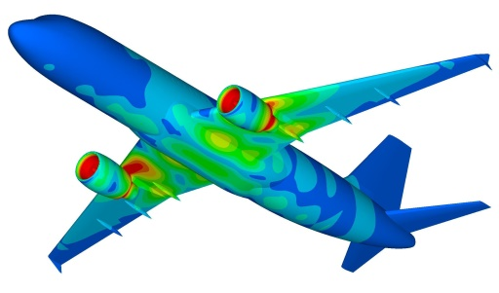
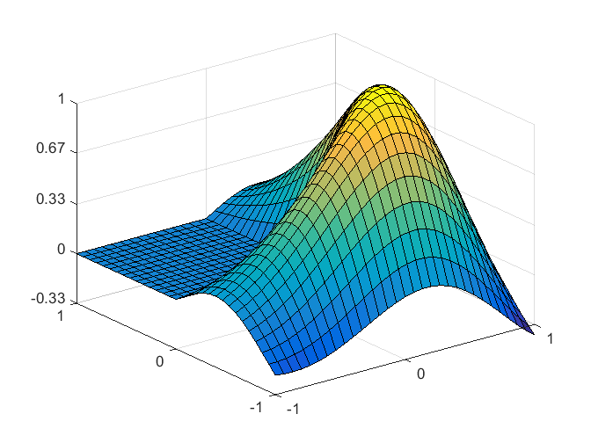
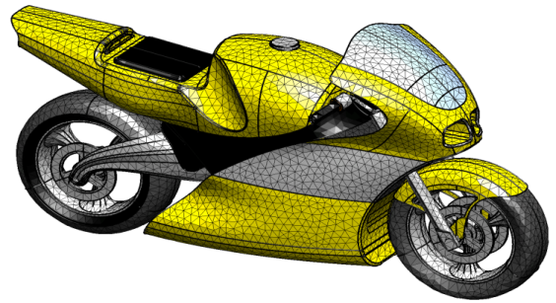
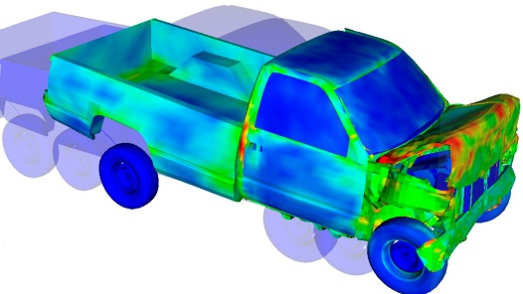
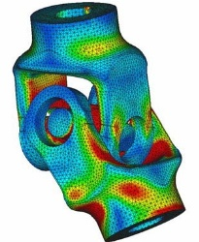
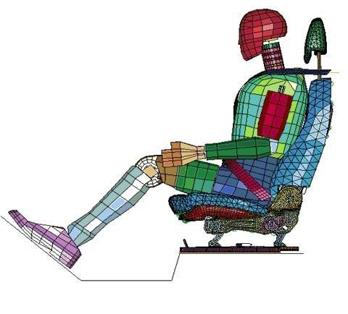
Linear Systems of Equations
Dr. Himanshu Pathak
himanshu@iitmandi.ac.in

Slide 2
Systems of Equations
Recall that a system of two linear equations in two variables may be written in the general form
where a, b, c, d, h, and k are real numbers and neither a and b nor c and d are both zero.
Recall that the graph of each equation in the system is a straight line in the plane, so that geometrically, the solution to the system is the point(s) of intersection of the two straight lines L₁ and L₂, represented by the first and second equations of the system.

Slide 3
Systems of Equations
Given the two straight lines L₁ and L₂, one and only one of the following may occur:
1. L₁ and L₂ intersect at exactly one point.
y
L₁
Unique solution
(x₁, y₁)
y₁
(x₁, y₁)
x₁
x
L₂

Slide 4
Systems of Equations
Given the two straight lines L₁ and L₂, one and only one of the following may occur:
2. L₁ and L₂ are coincident.
y
L₁, L₂
Infinitely many solutions
x

Slide 5
Systems of Equations
Given the two straight lines L₁ and L₂, one and only one of the following may occur:
3. L₁ and L₂ are parallel.
y
L₁
L₂
No solution
x

Slide 6
Example: A System of Equations With Exactly One Solution
Consider the system
Solving the first equation for y in terms of x, we obtain
Substituting this expression for y into the second equation yields

Slide 7
Example: A System of Equations With Exactly One Solution
Finally, substituting this value of x into the expression for y obtained earlier gives
Therefore, the unique solution of the system is given by x = 2 and y = 3.

Slide 8
Example: A System of Equations With Exactly One Solution
Geometrically, the two lines represented by the two equations that make up the system intersect at the point (2, 3):
y
6
5
4
3
2
1
–1
(2, 3)
x
1 2 3 4 5 6

Slide 9
Example: A System of Equations With Infinitely Many Solutions
Consider the system
Solving the first equation for y in terms of x, we obtain
Substituting this expression for y into the second equation yields
which is a true statement.
This result follows from the fact that the second equation is equivalent to the first.
y
6
5
4
3
2
1
–1
x
1 2 3 4 5 6

Slide 10
Example: A System of Equations That Has No Solution
Consider the system
Solving the first equation for y in terms of x, we obtain
Substituting this expression for y into the second equation yields
which is clearly impossible.
Thus, there is no solution to the system of equations.
y
6
5
4
3
2
1
–1
x
1 2 3 4 5 6

Slide 11
The Gauss Elimination Method
The Gauss elimination method is a technique for solving systems of linear equations of any size.
The operations of the Gauss-elimination method are
Convert into upper triangle matrix.
Get one of known value from last equation.
Substitute the known variable into upper equations (Back Substitution).

Slide 12
Example
Solve the following system of equations:
Solution
First, we transform this system into an equivalent system in which the coefficient of x in the first equation is 1:
Multiply the equation by 1/2

Slide 13
Example
Solve the following system of equations:
Solution
First, we transform this system into an equivalent system in which the coefficient of x in the first equation is 1:
Multiply the first equation by 1/2

Slide 14
Example
Solve the following system of equations:
Solution
Next, we eliminate the variable x from all equations except the first:
Replace by the sum of – 3 X the first equation + the second equation

Slide 15
Example
Solve the following system of equations:
Solution
Next, we eliminate the variable x from all equations except the first:
Replace by the sum of – 3 ☓ the first equation + the second equation

Slide 16
Example
Solve the following system of equations:
Solution
Next, we eliminate the variable x from all equations except the first:
Replace by the sum of the first equation + the third equation

Slide 17
Example
Solve the following system of equations:
Solution
Next, we eliminate the variable x from all equations except the first:
Replace by the sum of the first equation + the third equation

Slide 18
Example
Solve the following system of equations:
Solution
Then we transform so that the coefficient of y in the second equation is 1:
Multiply the second equation by 1/2

Slide 19
Example
Solve the following system of equations:
Solution
Then we transform so that the coefficient of y in the second equation is 1:
Multiply the second equation by 1/2

Slide 20
Example
Solve the following system of equations:
Solution
We now eliminate y from third equation:
Replace by the sum of the third equation + (–3) ☓ the second equation

Slide 21
Example
Solve the following system of equations:
Solution
We now eliminate y from third equation:

Slide 22
Example
Solve the following system of equations:
Solution
Thus, after back substitution the solution to the system is x = 3, y = 1, and z = 2.

Slide 23
Example
Solve the following system of equations:
Step: 1
Pivot is a₁₁;
multiply first row by (- a₂₁/ a₁₁) and add the results to second row
multiply first row by (- a₃₁/ a₁₁) and add the results to third row
multiply first row by (- a₄₁/ a₁₁) and add the results to forth row

Slide 24
Example
Solve the following system of equations:
Step: 2
Pivot is a₂₂;
multiply second row by (- a₃₂/ a₂₂) and add the results to third row
multiply second row by (- a₄₂/ a₂₂) and add the results to fourth row

Slide 25
Example
Solve the following system of equations:
Step: 3
Pivot is a₃₃;
multiply third row by (- a₄₃/ a₃₃) and add the results to fourth row

Slide 26
Example
Step: 4
Back Substitution;

Slide 27
MATLAB© Script
Simplest Gauss Elimination Program within MATLAB to solve linear system of equations
Coefficient Matrices
[n, nn] = size(A); % Check the size of coefficient matrix
C = [A b]; % Create Augmented matrix
for i = 1: n-1 % Loop over pivot row (i)
for k = i+1 : n % Elimination on row k
m(k, i) = - C(k, i) / C(i, i); % Coefficient for elimination
C(k, :) = C(k, :) + m(k, i) * C(i, :); % Elimination done at k_{th} row
end
end
x(n, 1) = C(n, n+1) / C(n, n); % Last variable
for i = n-1: -1: 1 % Loop for back substitution
x(i, 1) = (C(i, n+1) – C(i, i+1:n) * x(i+1: n, 1)) / C(i, i); % Back substitution
end
X=rref(C) % Solution from inbuilt function to check correctness of result

Slide 28
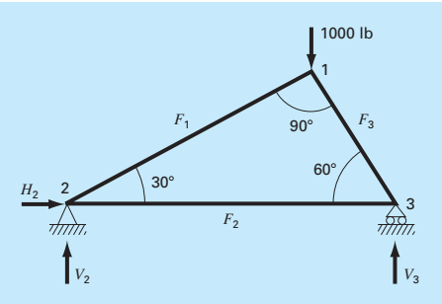
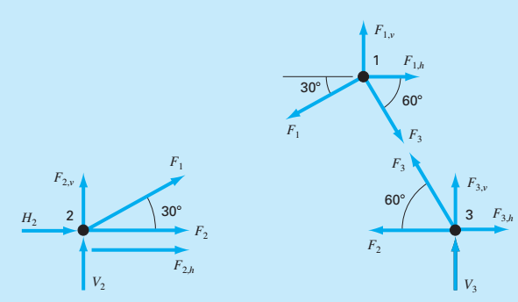
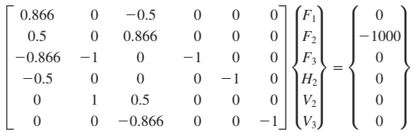




Implementation
Analysis of a Statically Determinate Truss
At node 1,
At node 2,
At node 3,

Slide 29
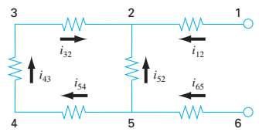
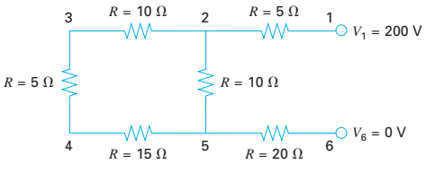
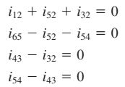
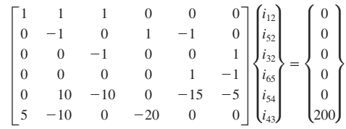



Implementation
Analysis of a Resistor Circuit
Kirchhoff's current rule:
Kirchhoff's voltage rule:

Slide 30
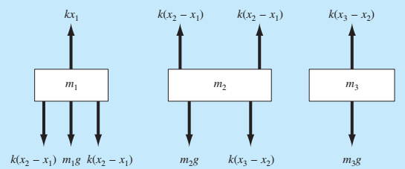
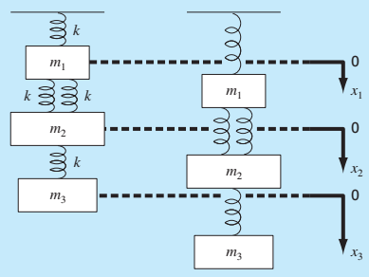





Implementation
Analysis of a Spring-Mass System
Newton’s 2nd Law:
For 1st mass:
For 2nd mass:
For 3rd mass:

Slide 31
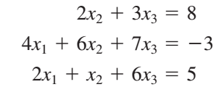
Other Related Issues
If Pivot element is zero or near to zero
Gauss Elimination with Row Pivoting
Round-off errors: It accumulated and propagated during the elimination process;
Important when dealing with 100 or more equations.
Ill-Conditioned Systems: Small changes in coeffcients result in large changes in the solution.
Determinant of system matrix is near to zero.

Slide 32

Improvement Techniques
Gauss Elimination with Row Pivoting
More significant number in solution
Gauss-Jordan: forward elimination for below diagonal elements backward elimination for above diagonal elements diagonal elements scaled to one
(Reduced Row Echelon Form).

Slide 33
Other Related Issues
Tridiagonal Systems (in FEM): Pivot element scaled to 1 preceding Gauss Elimination.
Computational Effort: floating point operations (flops)
Flops: number of executable operations in terms of multiplication and division.
Gauss Elimination:

Slide 34
LU Decomposition
Gauss Elimination solves [A]{x}={B} by forward elimination and back substitution employed over Augmented matrix [A | B].
It becomes insufficient when solving these equations for different values of {B}
LU decomposition is very useful when the vector of variables {x} is estimated for different parameter vectors {B} since the forward elimination process employed over [A] only.
LU Decomposition
L: lower triangular matrix; U: upper triangular matrix
Then, [A]{X}={B} can be decomposed into two matrices [L] and [U] such that: [L][U]=[A]

Slide 35
LU Decomposition
[A]{X}={B} can be solved by LU decomposition using following steps:
[L][U] = [A] ➔ ([L] [U]) {X} = {B}
Consider: [U]{X} = {D}
So, [L]{D} = {B}
[L] {D} = {B} is used to generate an intermediate vector {D} by forward substitution.
[U] {X} = {D} is used to get {X} by back substitution.

Slide 36
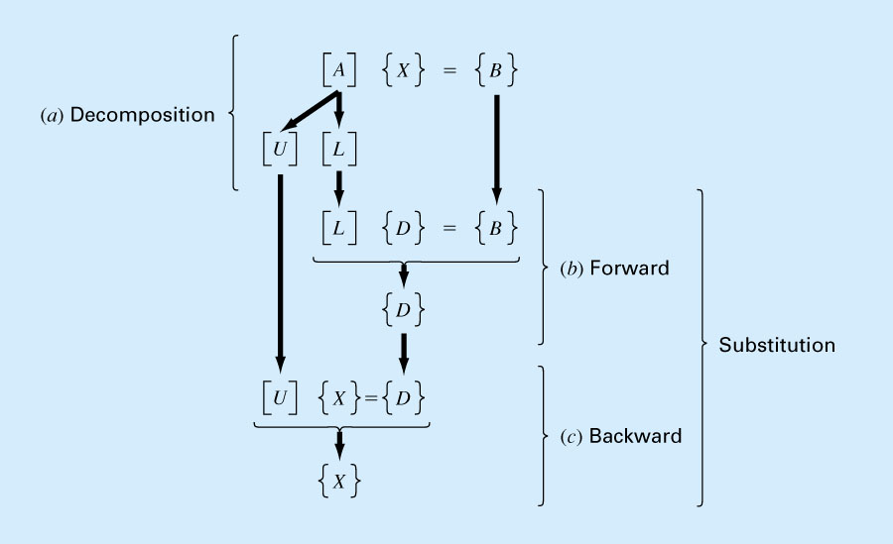
LU Decomposition

Slide 37
LU Decomposition
System of linear equations [A]{x}={B}
Step 1: Decomposition

Slide 38
LU Decomposition
Step 2: Generate an intermediate vector {D} by forward substitution
Step 3: Get {X} by back substitution.

Slide 39
MATLAB© Script
Simplest LU Decomposition Program within MATLAB
Linear Equation
[n, m] = size(A); % Check the size of coefficient matrix
L = eye(n); % Initialize L matrix with diagonal 1
U = A; % Initially U matrix start with value of A matrix
for i = 1: n-1 % Loop over pivot row (i)
for j = i+1 : n % Elimination on row j
L(j, i) = U(j, i) / U(i, i); % Coefficient for elimination
U(j, :) = U(j, :) - L(j, i) * U(i, :); % Elimination done at j_{th} row
end
end

Slide 40
MATLAB© Script
Simplest forward and backward substitution program to calculate intermediate matrix D
[L] {D} = {B}
Forward substitution
d(1, 1) = b(1, 1); % First variable
for i = 2:n % Loop for forward substitution
d(i, 1) = b(i, 1) – L(i, 1:i-1) * d(1: i-1, 1); % Forward substitution
end
Backward substitution
x(n, 1) = d(n, 1) / U(n, n); % Last variable
for i = n-1: -1: 1 % Loop for back substitution
x(i, 1) = (d(i, 1) – U(i, i+1:n) * x(i+1: n, 1)) / U(i, i); % Back substitution
end
[U]{X} = {D}

Slide 41
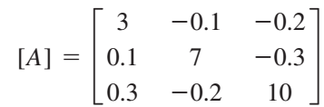
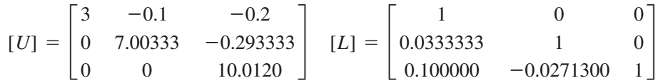
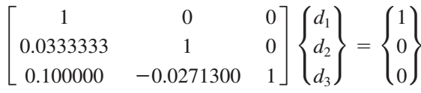
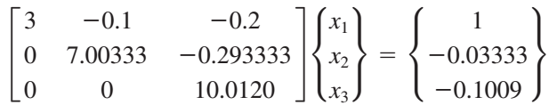
LU Decomposition for Matrix Inverse
Matrix
LU Decomposition
For first column calculation
[L] {D} = {P}
[U] {X} = {D}
Here, {X} is the first column
for [A]⁻¹

Slide 42
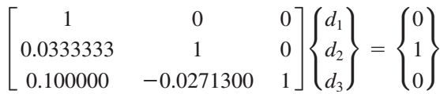
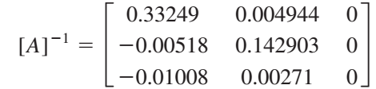
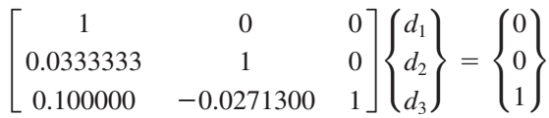
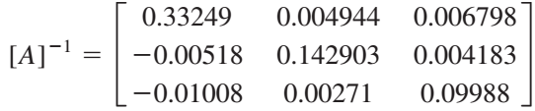
LU Decomposition for Matrix Inverse
For second column calculation
[L] {D} = {P}
[U] {X} = {D}
Here, {X} is the second column for [A]⁻¹
For third column calculation

Slide 43
Introduction
If systems of linear equations are very large, the computational effort of direct methods is prohibitively expensive.
Three common classical iterative techniques for linear systems
The Jacobi method
Gauss-Seidel method
Successive Over Relaxation (SOR) method
For systems that have coefficient matrices with the appropriate structure – especially large, sparse systems (many coefficients whose value is zero) – iterative techniques may be preferable.

Slide 44
Iterative Methods
A system of equations should be converted into matrix form.
The diagonal variable will be evaluated with initial guess.
Jacobi Iteration:
Gauss Iteration:
SOR Iteration:

Slide 45
Jacobi Iterative Technique
Consider the following set of equations.
Convert the set Ax = b in the form of
x = Cx + d.

Slide 46
Jacobi Iterative Technique Contd..
Start with an initial approximation of:

Slide 47

Jacobi Iterative Technique Contd..
In the generalized way:
Results of Jacobi Iteration:
k | 0 | 1 | 2 | 3
 | 0.0000 | 0.6000 | 1.0473 | 0.9326
 | 0.0000 | 2.2727 | 1.7159 | 2.0530
 | 0.0000 | -1.1000 | -0.8052 | -1.0493
 | 0.0000 | 1.8750 | 0.8852 | 1.1309
Himanshu Pathak

Slide 48
MATLAB© Script
Simplest MATLAB Program for Jacobi Iterative Method
clear all
clc
A = [2 -1 1;1 2 -1;1 -1 2];
b=[-1;6;-3];
x0=[0;0;0];
max=1000;
tol=1e-4;
[n,m]=sfize(A);
xold=x0;
C=-A;
for i=1:n
C(i,i)=0;
end
for i=1:n
C(i,:)=C(i,:)/A(i,i);
end
for i=1:n
d(i,1)=b(i)/A(i,i);
end
i=1;
while i<=max
xnew = C*xold+d;
if norm(xnew-xold) <= tol
x = xnew;
disp('Jacobi method converge');
disp([i xnew'])
return
else
xold = xnew;
end
i = i + 1;
end
x = xnew;
disp('Method did not Converge')

Slide 49
Gauss-Siedel Technique
Consider the following set of equations.
Convert the set Ax = b in the form of
x = Cx + d.

Slide 50
Gauss-Siedel Technique Contd..
Start with an initial approximation of:

Slide 51
Gauss-Siedel Technique Contd..
Results of Gauss-Seidel Iteration:
(Blue numbers are for Jacobi iterations.)
The solution is: x₁= 1, x₂ = 2, x₃ = -1, x₄ = 1
k | 0 | 1 | 2 | 3
 | 0.0000 | 0.6000 0.6000 | 1.0300 1.0473 | 1.0065 0.9326
 | 0.0000 | 2.3272 2.2727 | 2.0370 1.7159 | 2.0036 2.0530
 | 0.0000 | -0.9873 -1.1000 | -1.0140 -0.8052 | -1.0025 -1.0493
 | 0.0000 | 0.8789 1.8750 | 0.9844 0.8852 | 0.9983 1.1309
It required 15 iterations for Jacobi method and 7 iterations for Gauss-Seidel method to arrive at the solution with a tolerance of 0.00001.
Himanshu Pathak

Slide 52
MATLAB© Script
Simplest MATLAB Program for Gauss-Siedel Iterative Method
clear all
clc
A = [2 -1 1;1 2 -1;1 -1 2];
b=[-1;6;-3];
x0=[0;0;0];
max=1000;
tol=1e-4;
[n,m]=size(A);
x=x0;
C=-A;
for i=1:n
C(i,i)=0;
end
for i=1:n
C(i,:)=C(i,:)/A(i,i);
end
for i=1:n
d(i,1)=b(i)/A(i,i);
end
i=1;
while i<=max
xold=x;
for j=1:n
x(j) = C(j,:) * x + d(j);
end
if norm(x-xold) <= tol
disp(‘Gauss-Siedel method converge');
disp([i x'])
return
end
i = i + 1;
end
disp('Method did not Converge')

Slide 53
Convergence
For any iterative numerical technique, each successive iteration results in a solution that moves progressively closer to the true solution. This is known as convergence.
Jacobi
For each row, magnitude of diagonal element of A should be greater than the sum of the magnitudes of the other elements in the row.
Magnitude of the largest eigenvalue of the iterative matrix C should be less than 1.

Slide 54
Convergence Contd…
Gauss-Siedel
If matrix A is real and symmetric, with positive diagonal elements, Gauss-Siedel will converge for any initial guess value; provided all eigenvalue of A are real and positive.
Although the more rapid convergence of Gauss-Siedel is an advantage; Jacobi can be used in parallel computation.

Slide 55
SOR Iteration
Relaxation (weighting) factor : ω
Gauss-Siedel Method: ω = 1
Over relaxation: 1 < ω < 2
Under relaxation: 0 < ω < 1
Relaxation Iteration:

Slide 56
SOR Iteration

Slide 57
SOR Iteration Example
Consider the following set of equations.
Assume x₁ = x₂ = x₃ = 0, and ω = 1.2
First iteration

Slide 58
SOR Iteration Example Contd..
Second iteration
Third iteration
To achieve fast convergence, relaxation parameter (ω) should be optimum..

Slide 59
SOR Iteration Example Contd..
Result obtained at each iteration for ω=1.2
» w=1.2; x =
i x1 x2 x3 ....
1.0000 -0.6000 7.2900 7.7000
2.0000 4.0170 1.6767 8.4685
3.0000 1.6402 4.9385 7.1264
4.0000 2.6914 3.3400 7.9204
5.0000 2.2398 4.0661 7.5358
6.0000 2.4326 3.7474 7.7091
7.0000 2.3504 3.8851 7.6334
8.0000 2.3855 3.8261 7.6661
9.0000 2.3705 3.8513 7.6521
10.0000 2.3769 3.8405 7.6580
11.0000 2.3742 3.8451 7.6555
12.0000 2.3753 3.8432 7.6566
13.0000 2.3749 3.8440 7.6561
14.0000 2.3751 3.8436 7.6563
15.0000 2.3750 3.8438 7.6562
16.0000 2.3750 3.8437 7.6563
17.0000 2.3750 3.8438 7.6562
18.0000 2.3750 3.8437 7.6563
19.0000 2.3750 3.8438 7.6562
20.0000 2.3750 3.8437 7.6563
21.0000 2.3750 3.8438 7.6562
SOR method converged
» [A,b]=Example
A =
4 -1 -1
6 8 0
-5 0 12
b =
-2
45
80
» x0=[0 0 0]'
x0 =
0
0
0
» tol=1.e-6
tol =
1.0000e-006
Himanshu Pathak

Slide 60
SOR Iteration Example Contd..
Result obtained at each iteration for ω=1.5
» w = 1.5; x =
i x1 x2 x3 ....
1.0000 -0.7500 9.2812 9.5312
2.0000 6.6797 -3.7178 9.4092
3.0000 -1.9556 12.4964 4.0732
4.0000 6.4414 -5.0572 11.9893
5.0000 -1.3712 12.5087 3.1484
6.0000 5.8070 -4.3497 12.0552
7.0000 -0.7639 11.4718 3.4949
8.0000 5.2445 -3.1985 11.5303
9.0000 -0.2478 10.3155 4.0800
10.0000 4.7722 -2.0890 10.9426
11.0000 0.1840 9.2750 4.6437
12.0000 4.3775 -1.1246 10.4141
13.0000 0.5448 8.3869 5.1335
14.0000 4.0477 -0.3097 9.9631
15.0000 0.8462 7.6404 5.5473
………
20.0000 3.3500 1.4220 9.0016
………
30.0000 2.7716 2.8587 8.2035
………
50.0000 2.4406 3.6808 7.7468
………
100.0000 2.3757 3.8419 7.6573
SOR method did not converge
» [A,b]=Example
A =
4 -1 -1
6 8 0
-5 0 12
b =
-2
45
80
» x0=[0 0 0]'
x0 =
0
0
0
» tol=1.e-6
tol =
1.0000e-006
Diverged !!
Himanshu Pathak

Slide 61
MATLAB© Script
Simplest MATLAB Program for SOR Iterative Method
clear all
clc
A = [2 -1 1;1 2 -1;1 -1 2];
b=[-1;6;-3];
x0=[0;0;0];
max=1000;
tol=1e-4;
w = 1.2;
[n,m]=size(A);
xold=x0;
C=-A;
for i=1:n
C(i,i)=0;
end
for i=1:n
C(i,:)=C(i,:)/A(i,i);
end
for i=1:n
d(i,1)=b(i)/A(i,i);
end
i=1;
while i<=max
xold = x;
for j=1:n
x(j) = (1-w)*xold(j) + w*(C(j,:)*x+d(j));
end
if norm(xold-x) <= tol
disp(‘SOR method Converge');
return
end
disp([i x’])
i = i + 1;
end
disp(‘SOR did not Converge')

Slide 62
Convergence
If 0<ω<2, SOR method converges for any initial vector if A matrix is symmetric and positive definite.
If ω>2, SOR method diverges.
If 0<ω<1, SOR method converges but the convergence rate is slower (deceleration) than the Gauss-Seidel method.
Computation Cost
The operation count for Gaussian Elimination or LU Decomposition was 0 (n³).
For iterative methods, the number of scalar multiplications is 0 (n²) at each iteration.
Iterative methods are well suited for sparse matrices.

Slide 63


THANK YOU
Questions??

